Slide 1
An Optimization Analysis about Advertising Campaign of Nike
TEAM:
XIAOYU ZHANG
WENZHUO LEI
XIAO WAN
XIAOZHOU YU
PROF: Alkis Vazacopoulos

Slide 2





INTRODUCTION
In sportswear industry, which is a pretty mature market, companies are hard to make innovative products to stand out.
Many companies spend enormous amounts of money to advertise their products. They want to ensure that they are spending their money wisely. Typically, they want to reach large numbers of various groups of potential customers and keep their advertising costs as low as possible.
In conclusion, using limited advertising budget efficiently is important for companies to win competitions.

Slide 3
PROBLEM STATEMENT
NIKE’s advertisements become better and better as time goes by, and they were named Advertiser of the year event two times. So NIKE is a good choice to study and be generalized to the whole sportswear industry.
We choose 7 different channels: Newspaper, Magazine, Radio, TV, Outdoor, Internet, Mobile. And their CPMs(cost per 1000 impressions) are provided.
NIKE targets it’s consumers toward young female.
Total budget is limited.
The task is to modify advertising budgets to each channel and maximize the total exposure.

Slide 4
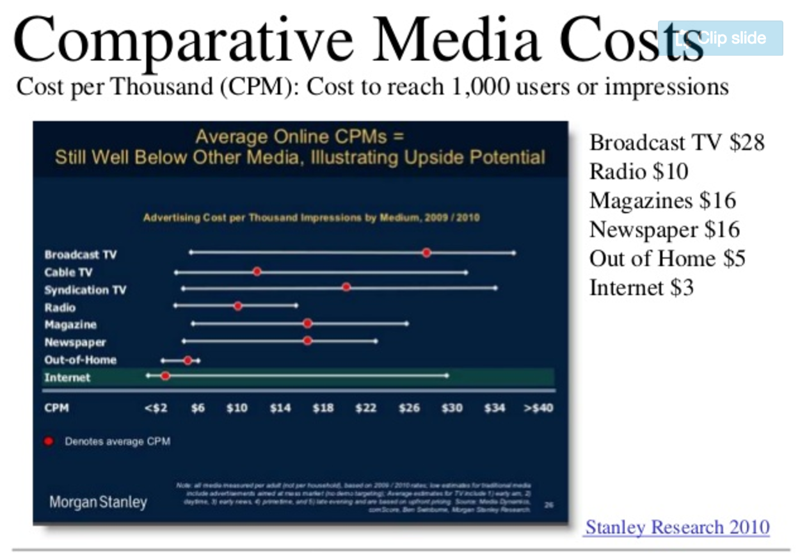
DATA COLLECTION
Collecting CPMs for different channels from Morgan Stanley’s research.

Slide 5
Collecting and dividing sample audience perspective data based on sex and age.

Slide 6
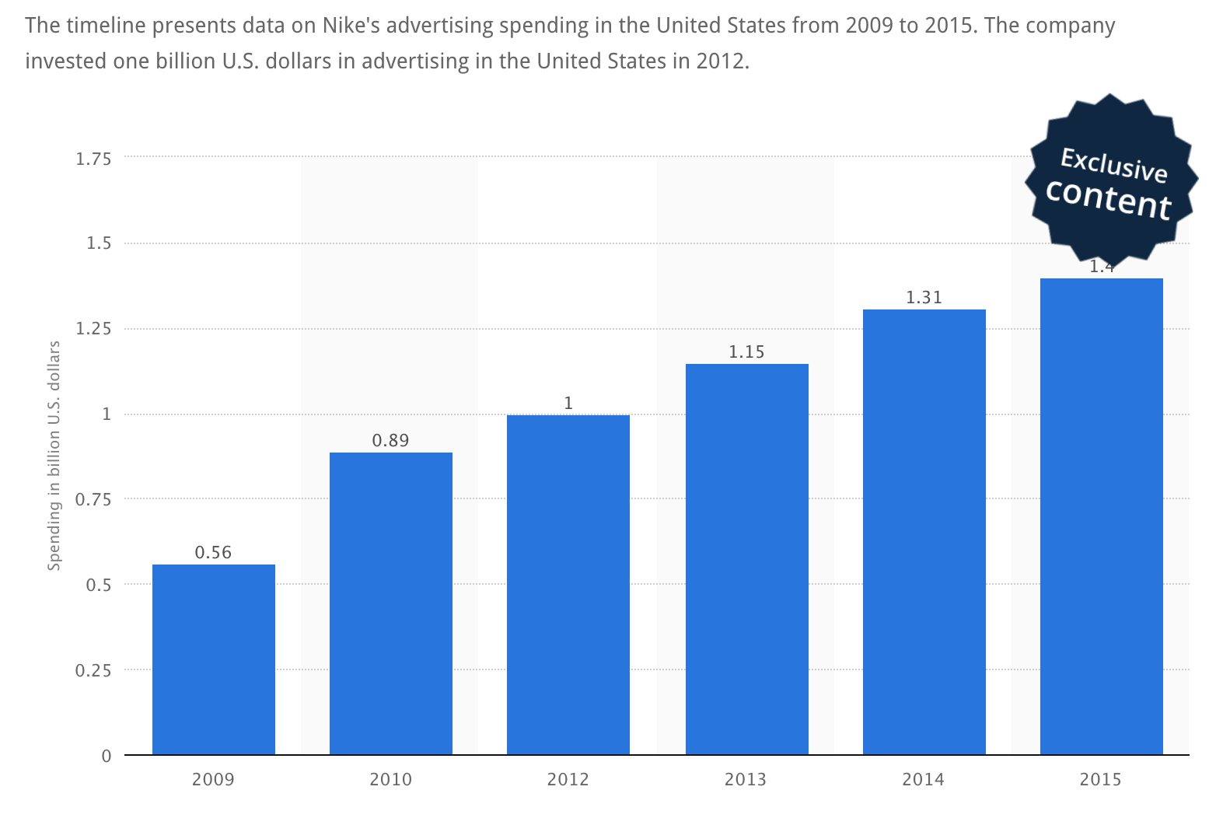
Collecting limited budget during 2009-2015 for NIKE. And using regression to predict NIKE advertising expenditure in 2015.

Slide 7
METHODOLOGY

Slide 8
Target: Achieve maximum amount of exposures within budget
Constraints:
At least 14% of total exposures should be women of 17 to 25 years old
At least 20% to the advertisement budget should be spent on TV channel
Traditional Channels (including Newspaper, Magazine, Radio, TV and Outdoor) should take up at least 50% of the total budget

Slide 9
CONCLUSION

Slide 10
STRENGTHS AND LIMITATIONS
Limitations:
For CPM, we choose average value according to the official range of CPMs, actually, many factors of channels can effect CPMs, such as: size, social status, coverage and so on.
It’s difficult to get NIKE’s specific required exposure.
In realistic applications, purpose of advertising is to increase awareness of products instead of reaching a certain coverage value.

Slide 11
THANK YOU!

